Slide 1

Requirements Presentation
Uday Cherukuri
Joey Dyer
Andrew Wallace
Notes:
Joey

Slide 2
Description of Man’s Best Friend
Android application designed to assist users with taking care of their dog
Not only provide tools and information to the user, but also allow users to communicate with the dog owner community around them
Profiles for each dog the user owns allows the app to tailor the information, reminders, and overall experience to the user’s needs
Notes:
Joey

Slide 3
Glossary
Breed - a specific group of domestic animals having homogeneous appearance (phenotype), homogeneous behavior, and/or other characteristics that distinguish it from other organisms of the same species and that were arrived at through selective breeding.
Profile - Data component that encapsulates all information associated with a specific dog. This includes picture, age, weight, breed, allergies, medical conditions, etc.
Vaccine - Medication periodically given to dogs in order to keep them disease free and healthy.
Bark - Community based message that will be viewable for everyone within a predefined radius of the sent location.
Activity - A message displayed in a log format that tells the user what actions have been performed for their dog, along with the time and date of that action and accompanied by an optional custom comment
Reminder - Uses Android calendar API to display messages to the user at set time intervals. These include predefined reminders (feed, bathe, medicate, walk, birthday) and users can add their own custom reminders as well
Informational Reminder - A message that is displayed immediately after a reminder that displays relevant information based on the type of reminder as well as the breed of dog that the reminder is associated with
Notes:
Joey

Slide 4
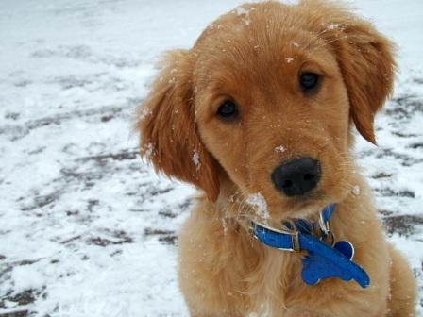
Functional Requirements
Profiles
Each device supports multiple dog profiles that contain information on the dog (pictures, breed, gender, age, etc.) as well as reminders and activities specific to that dog
Reminders
There are certain predefined reminders (birthday, feeding, bathing, walking, medication) that display reminder messages to the user after customizable amounts of time
Custom user-created reminders can also be added and deleted with identical functionality
Dog Database
SQLite database with information on the 50 most common dog breeds
Can be manually searched by users, but is also used to provide data for informational reminders
Notes:
Andrew

Slide 5
Functional Requirements Cont.
Barks
Send out a message that is viewable to every other user in your city (google location services API is used to get current location), similar to a tweet
Each message has tags associated with it (adoption, recommendation, warning, etc.) and are able to be “liked”
Activities
A log of all activities the user has performed with their dog
Log the type of activity, time and date of completion, and an optional user-created comment
e.g. March 2, 1:52pm: Fed Spot (Running low on food!)
Notes:
Andrew

Slide 6
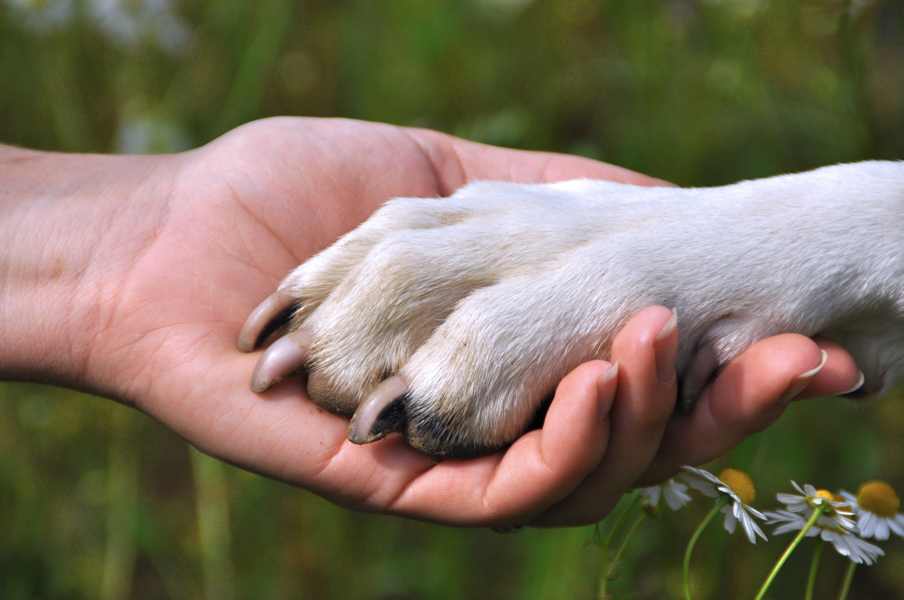
Non-Functional Requirements
Information in the dog database must be correct and accurate
The app should keep data isolated between separate profiles
The app should make efficient use of battery life
Notes:
Andrew

Slide 7
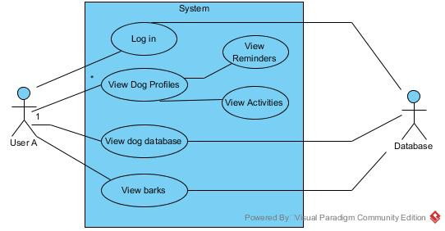
Use Case Diagram
Notes:
Uday

Slide 8
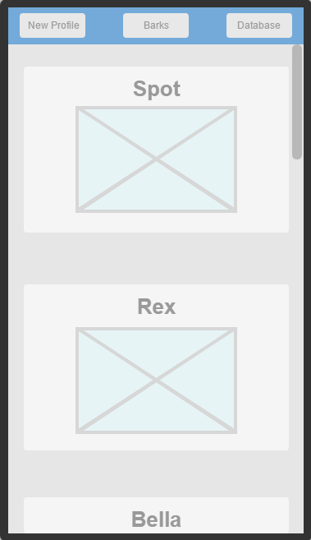
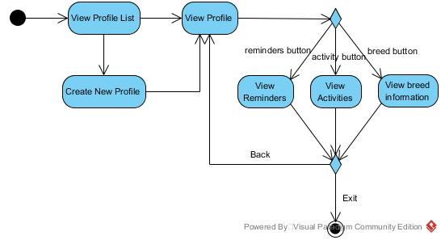
Dog Profiles
Notes:
Uday

Slide 9
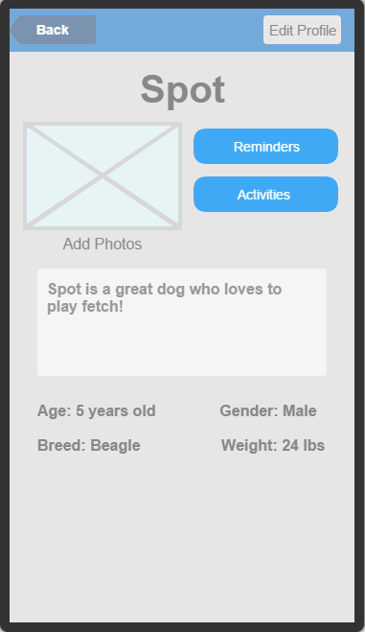
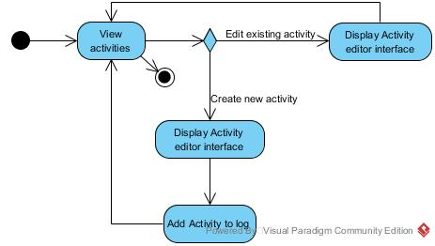
Dog Profile cont.
Notes:
Andrew

Slide 10
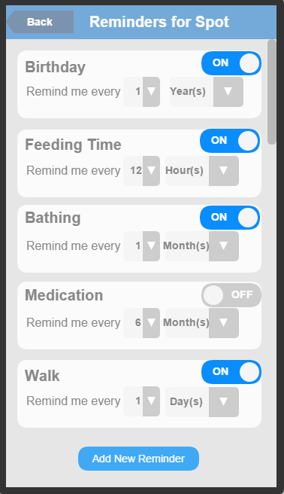
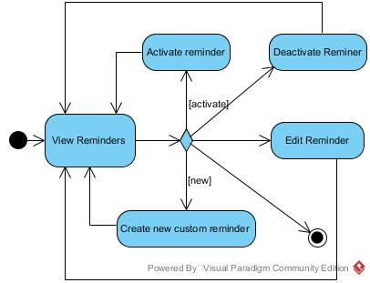
Reminders
Notes:
Joey

Slide 11
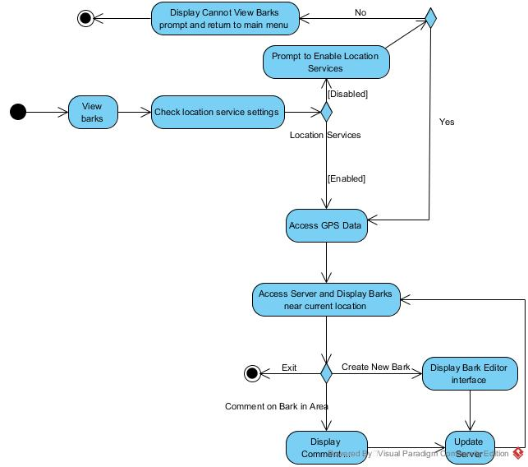
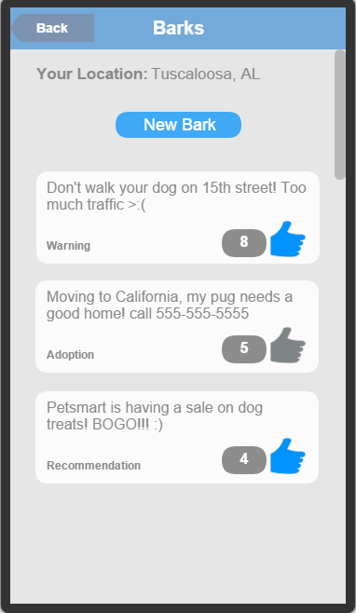
Barks
Notes:
Uday

Slide 12
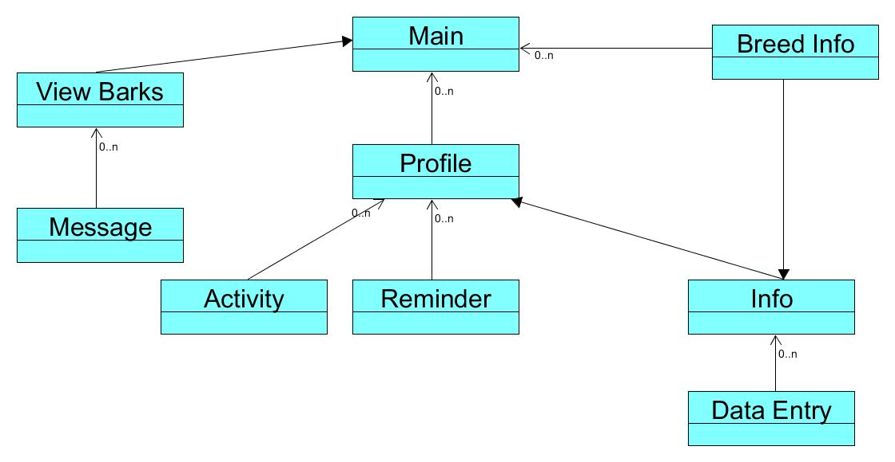
Class Diagram
Notes:
Andrew

Slide 13
Credits
Pet Adoption by Dan Hetteix from The Noun Project

